Slide 1
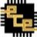


HOME
AUTOMATION
USING IOT
6 Credits
Project ID – W27

Slide 2


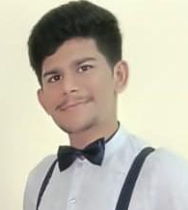

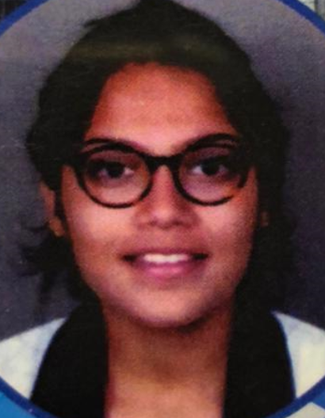
TEAM COMPOSITION
ROHAN N KALPAVRUKSHA | PES1201802830
ROSHAN N KALPAVRUKSHA | PES1201802834
AKHIL V NAYGENALI | PES1201801945
MRIDHULA SRIHARSHA | PES1201801122
GUIDE - Dr. Anuradha M
Professor and Chairperson, ECE Department

Slide 3
CONTENTS
Introduction
Problem Statement
Block Diagram
Implementation progress
Deliverables
References
Project timeline Gantt Chart

Slide 4
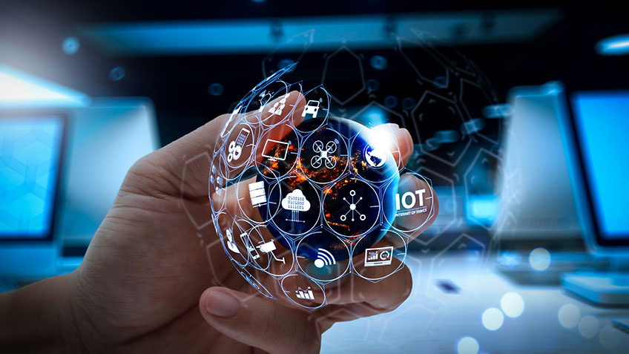
INTRODUCTION
Home Automation :
Automatically performs everyday functions around the home
Saves time, energy, money and provides security.
Internet of Things (IOT) :
Network of embedded objects
Connects and exchanges data with other devices over the internet.

Slide 5
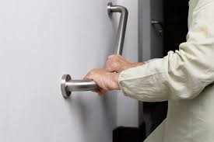
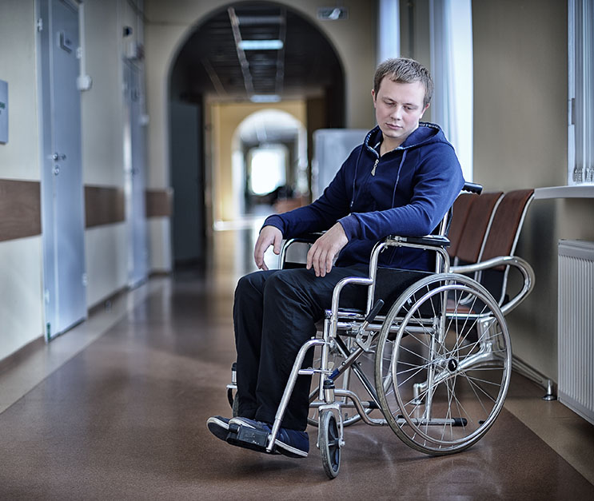
PROBLEM STATEMENT
Brain-numbing task to walk out from our place to control various electric devices
Motivation : Make it self-regulating for physically handicapped and old aged people.
Develop a wrist band to control devices.
Relatively affordable, simple to implement and users friendly.

Slide 6
BLOCK DIAGRAM
ONLINE DASHBOARD
CLOUD
CONTROL APP
CONTROL DEVICE
(SMART WATCH)
Slide Bar
Wi-Fi
Module
Speech Sensors
Levels Altered
Arduino IDE
Node MCU
LIGHT
FAN

Slide 7
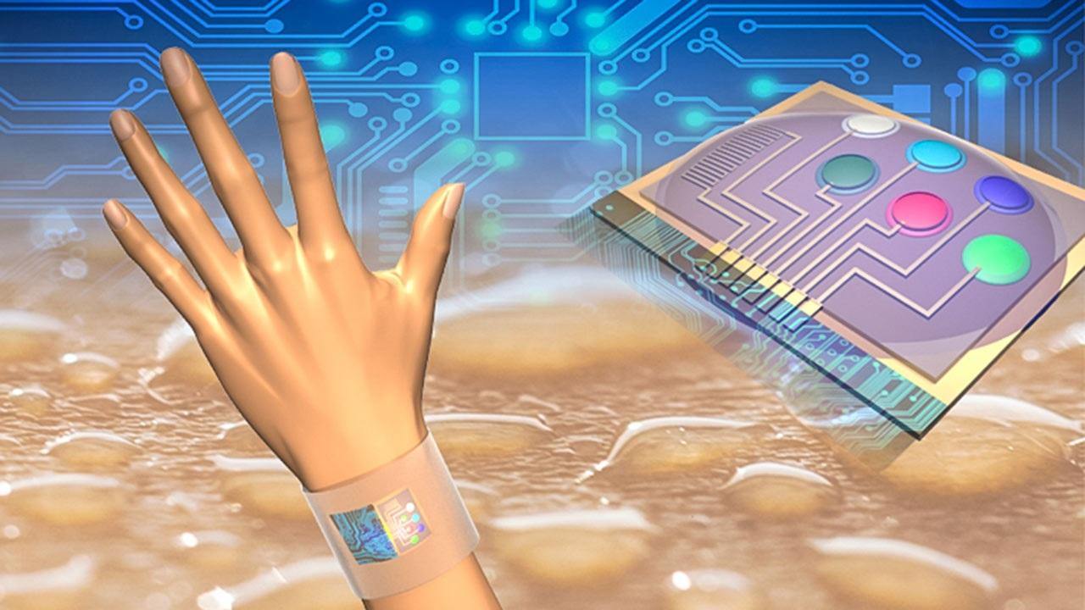
IMPLEMENTATION PROGRESS
We have tried to implement the controlling of intensity of bulb with the help of our gesture.
For example when we tilt our hand towards the right the bulb gets on to its high intensity and as we move towards the left the bulbs intensity goes on decreasing.

Slide 8
BLOCK DIAGRAM - GESTURE
(SMART WATCH)
Node Mcu sends HTTP request to server
Node Mcu Replies to the request server
Node MCU
Client
Node MCU
Server
WI-FI
Accelerometer
LIGHT
FAN
Senses Gesture

Slide 9
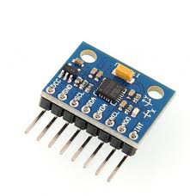
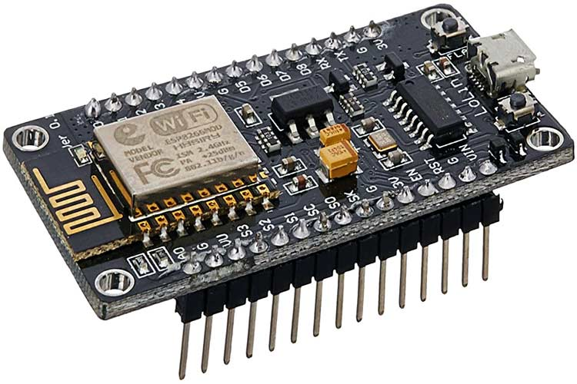
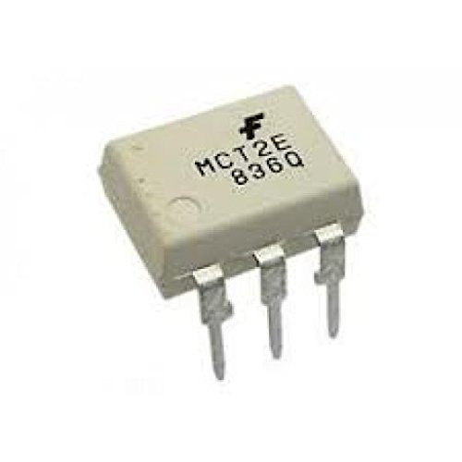
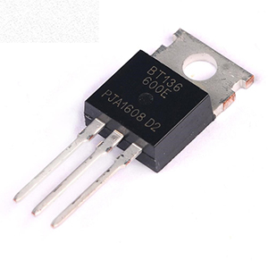
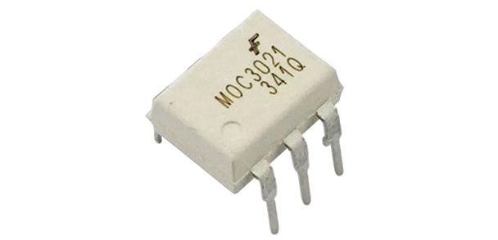
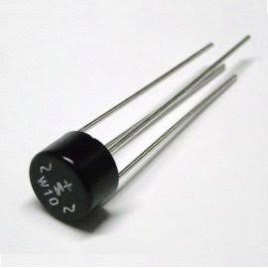

COMPONENTS
Accelerometer
MCT 2E Octocoupler
Node MCU
BT 136 Triac
MOC3021 Octocoupler
Bridge Rectifier
Arduino IDE Software
Resistors (47K, 1.8 K, 330E, 10K)
High Link (for Power)

Slide 10
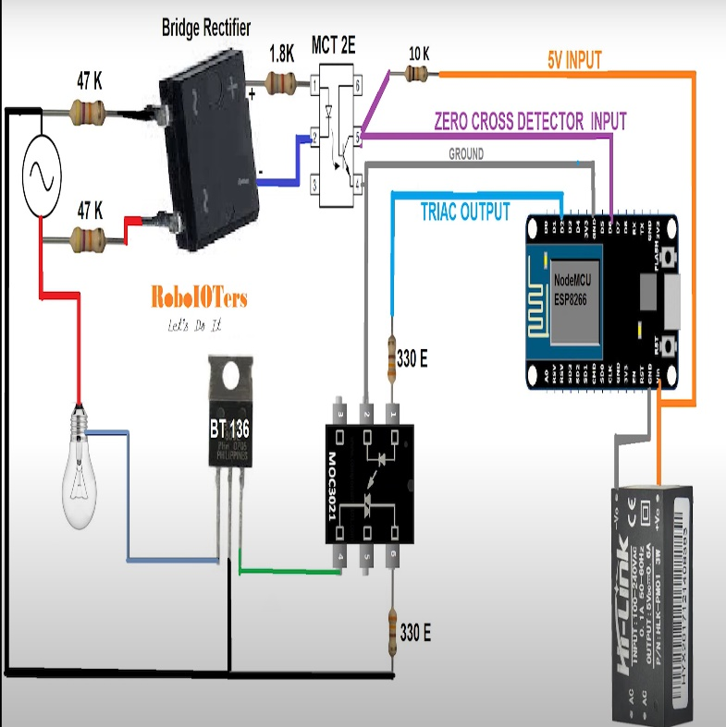
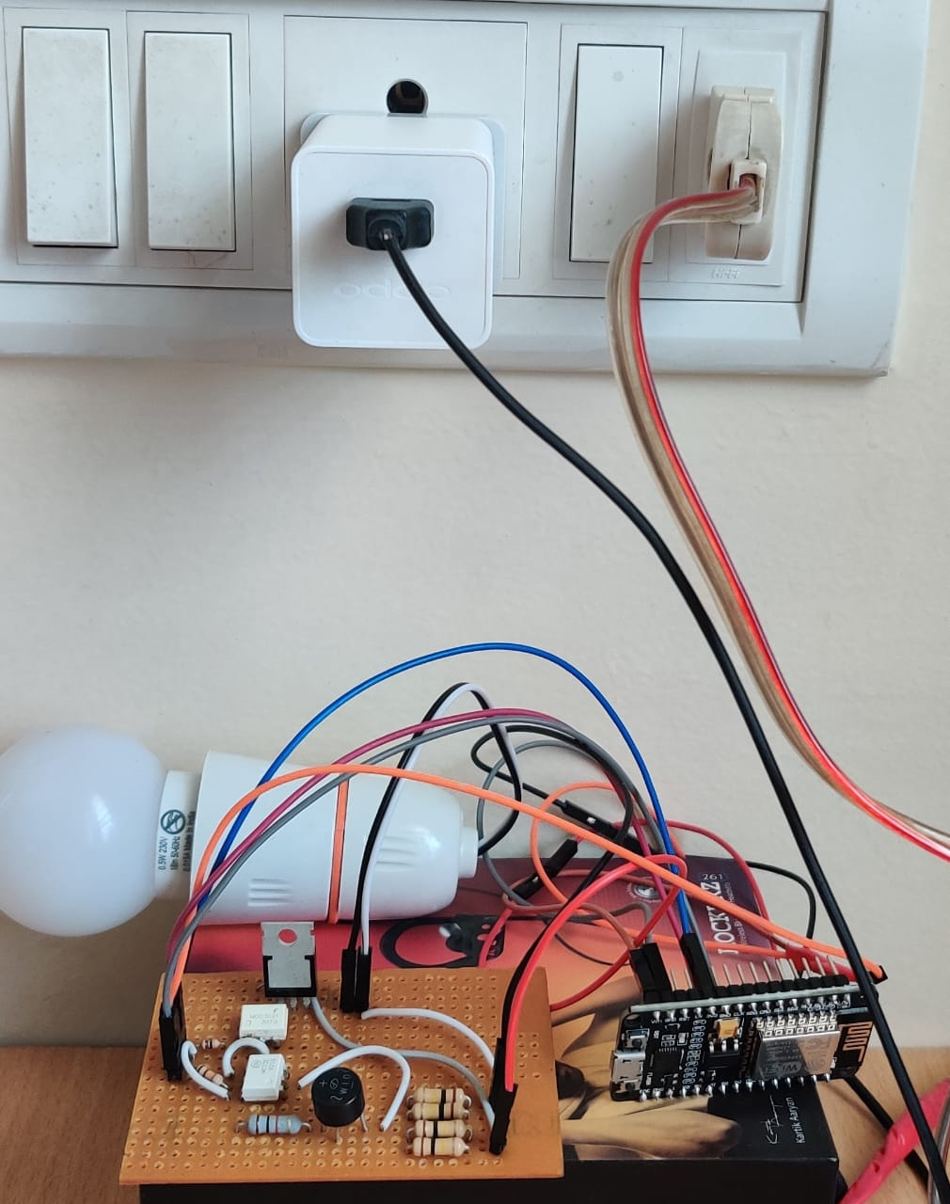
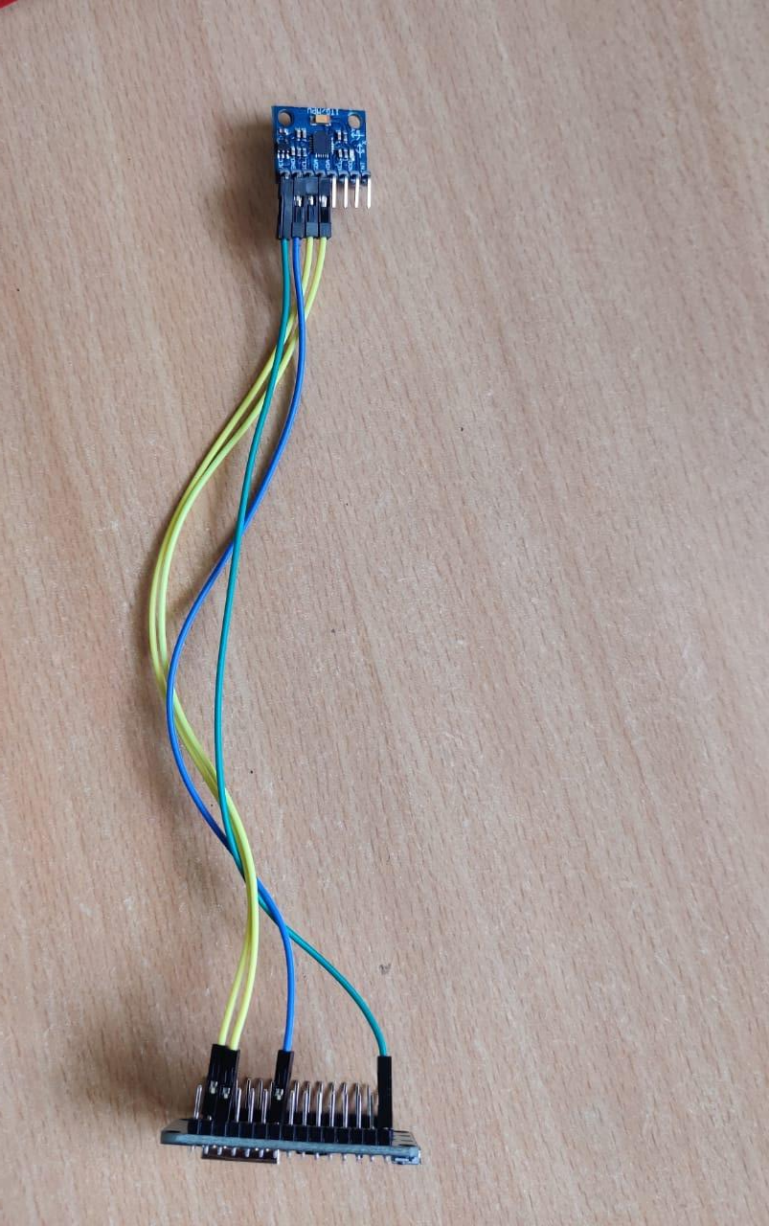
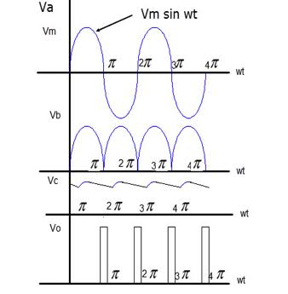
CIRCUIT
SETUP NEAR
SMART WATCH
SETUP NEAR BULB

Slide 11
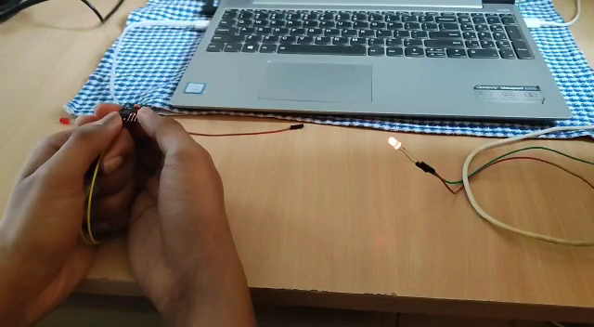
VIDEO

Slide 12
DELIVERABLES
Phase 1
Controlling of led through a Slide Bar using Blynk App
Phase 2
A smart Wristband to control the functions of the
light bulb and fan through slide bar, voice and gesture.
Technical paper writing.

Slide 13
REFERENCES
[1]Assad Mohammed , Amar Seeam , Xavier Bellekens z, Kamila Nieradzinska x, Visham Ramsurrun , “Gesture based IoT Light Control for Smart Clothing” , 2016 IEEE International Conference on Emerging Technologies and Innovative Business Practices for the Transformation of Societies (EmergiTech), Avaliable online: 10.1109/EmergiTech.2016.7737326
[2] Sajid Nagarboudi Patel a, R.D.Salagarb ,”A Review on Iot Light Control for Smart Clothing using Gesture Control”
International Journal of Innovative and Emerging Research in Engineering Volume 4, Issue 6, 2017.
[3] Yash Govilkar, Dr. Rupesh Jaiswal , “A Gesture Based Home Automation System” , International Journal for Research in Applied Science & Engineering Technology (IJRASET), Volume 7 Issue XI, Nov 2019, Available online: http://doi.org/10.22214/ijraset.2019.11081
[4] Osheen Bindroo, Komal Saxena, Sunil Kumar Khatri, “A Wearable NFC Wristband for Remote Home Automation System”, 2017 2nd International Conference on Telecommunication and Networks (TEL-NET), Available Online :10.1109/TEL-NET.2017.8343563
[5] Ravi Kishore Kodali, Borra Yatish Krishna Yogi, Gudibanda Nagesh Sharan Sai, Jehova Honey Domma, “Implementation of Home Automation Using CoAP”, 28-31 Oct. 2018 TENCON 2018 - 2018 IEEE Region 10 Conference
[6] Kamelya Dehghani Kohnehshahri, Mohammad Hasan Kargar, Fatemeh Soleimani-Roozbahani, “The Effect of Using COAP Protocol on Reducing Energy Consumption in Smart Houses”, Sep 8, 2018 Int. J. Advanced Networking and Applications Volume: 10Issue: 03Pages: 3843-3852 (2018) ISSN: 0975-0290

Slide 14
PROJECT TIMELINE (PHASE 2)
SCHEDULE | JUNE | JULY
IMPLEMENTATION OF ALGORITHM TO DETECT THE GESTURE
DEVELOPMENT OF GESTURE DETECTION SYSTEM
DESIGN OF THE WRISTBAND & INTEGRATE ALL THREE TECHNIQUE
FAIL SAFE SYSTEM
FINAL REPORT AND TECHNICAL PAPER WRITING

Slide 15
THANK YOU

